Slide 1

Fabrication Techniques

Slide 2
Fabrication Techniques
Conventional Fabrication
Digital Fabrication
Mass Fabrication
Turning
Milling
Welding
3D Printing
Laser Cutter
2D router
Plastic Injection Molding
Metal Stamping
Casting

Slide 3
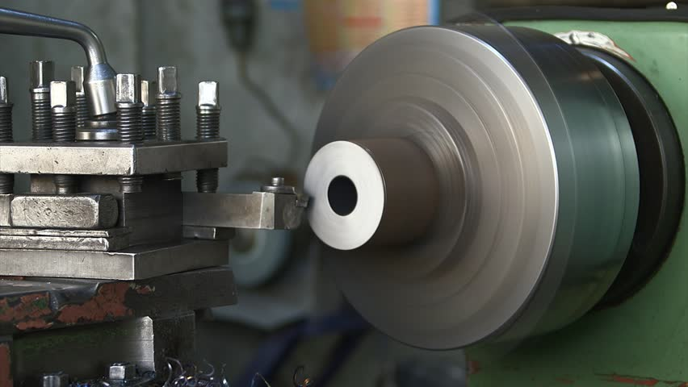
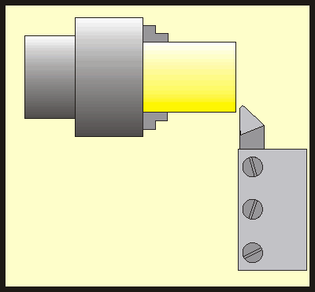
TURNING
Conventional Fabrication
A cylindrical component is clamped to a rotating chuck. A single pointed tool then moves along the axis of the component and removes material. This reduce the diameter of the part
https://www.youtube.com/watch?v=8EsAxOnzEms

Slide 4
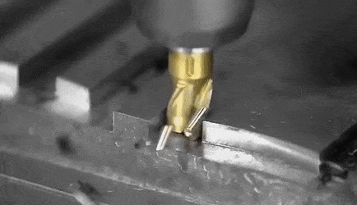
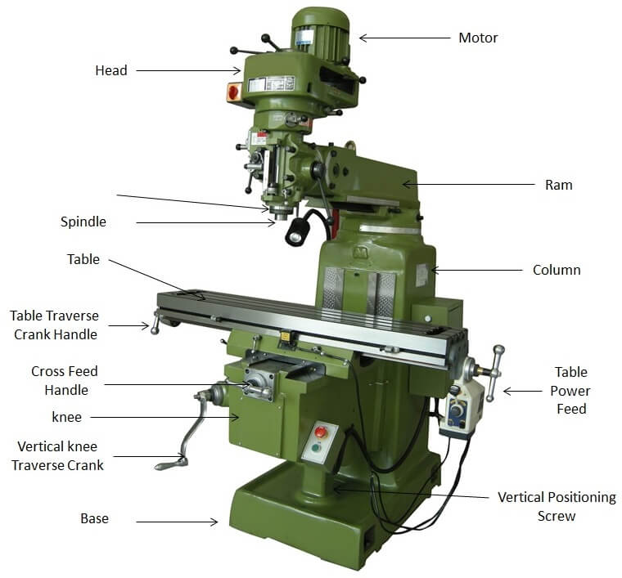
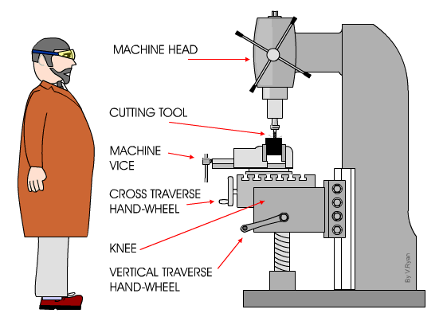
Milling
Conventional Fabrication
A prismatic part is clamped to the vice.
And a multi pointed tool is brought down to remove material in the X-Y-Z
https://www.youtube.com/watch?v=AxHexqN0Hr0

Slide 5
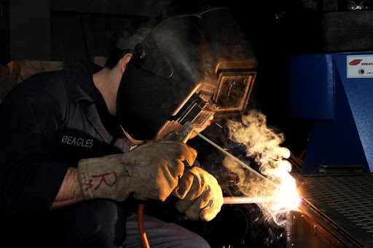
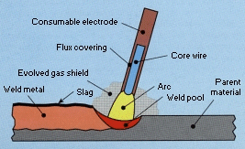
Welding
Conventional Fabrication
The joining of metal parts together can be done by
-Arc welding
https://www.youtube.com/watch?v=CoHVA7nr82A
-Gas welding
https://www.youtube.com/watch?v=PbJ6KnV3oFc
-Tungsten Inert Gas Welding (TIG)
https://www.youtube.com/watch?v=uO5pVLOAmD4

Slide 6
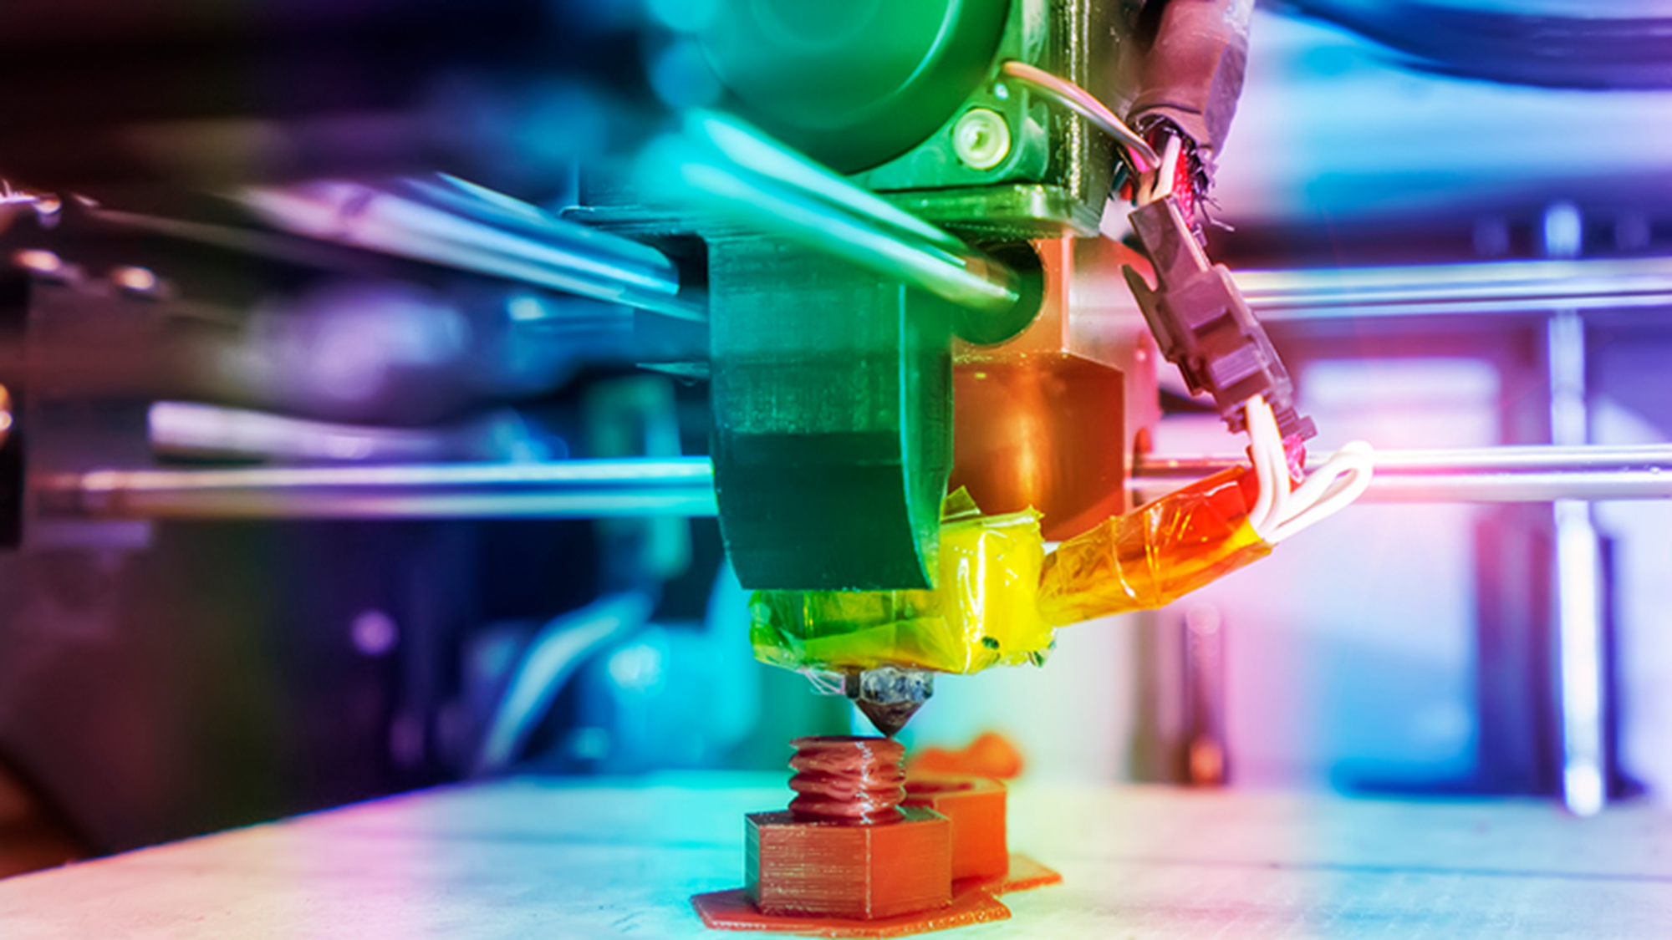
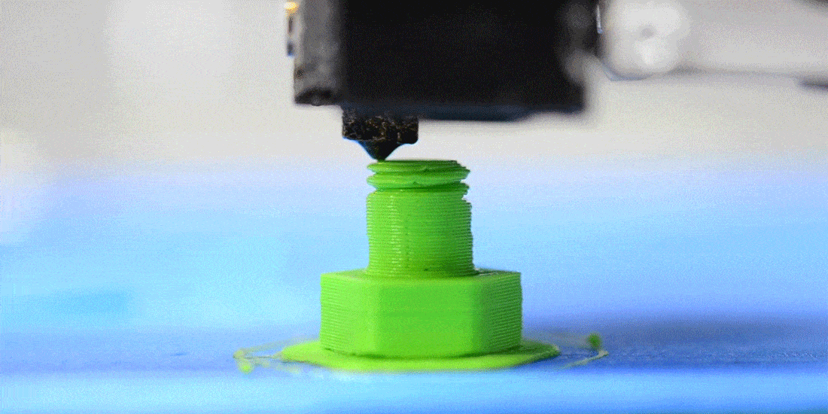
3D Printing
Digital Fabrication
Also known as additive manufacturing. There are various technologies involved in 3D printing. We commonly do FDM.
-FDM (Fused Deposition Modeling)
https://www.youtube.com/watch?v=GxLjDNrQBgs
-SLA (Stereolitography)
https://www.youtube.com/watch?v=yW4EbCWaJHE
-SLS (Selective Laser Sintering)
https://www.youtube.com/watch?v=P_9z5XN5gT4

Slide 7
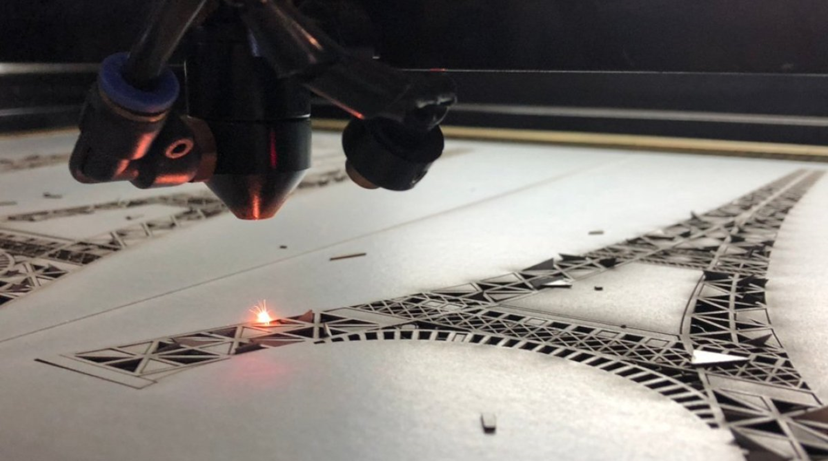
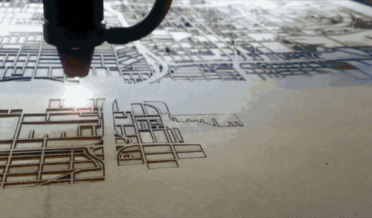
Laser Cutting
Digital Fabrication
Mostly cuts cardboard, acrylics and plywood.
https://www.youtube.com/watch?v=SIjUVCho_xU

Slide 8
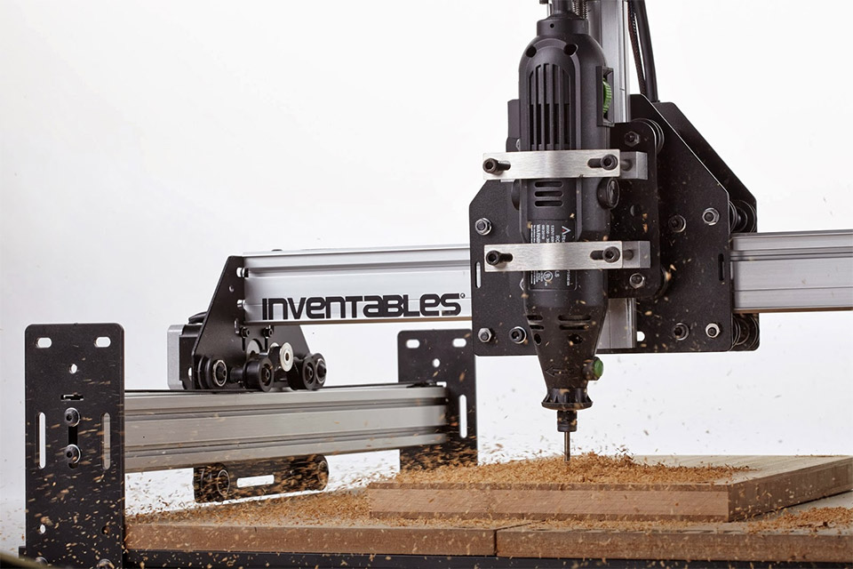
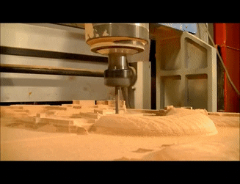
CNC Routing
Digital Fabrication
Very similar to a milling machine, but has spindle is mounted on a large XY platform that
https://www.youtube.com/watch?v=YBGqknN3gGs

Slide 9
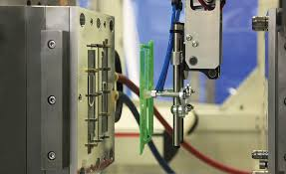
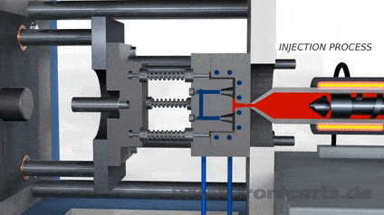
Plastic Molding
Mass Fabrication
For mass production of plastic parts.
https://www.youtube.com/watch?v=RMjtmsr3CqA

Slide 10
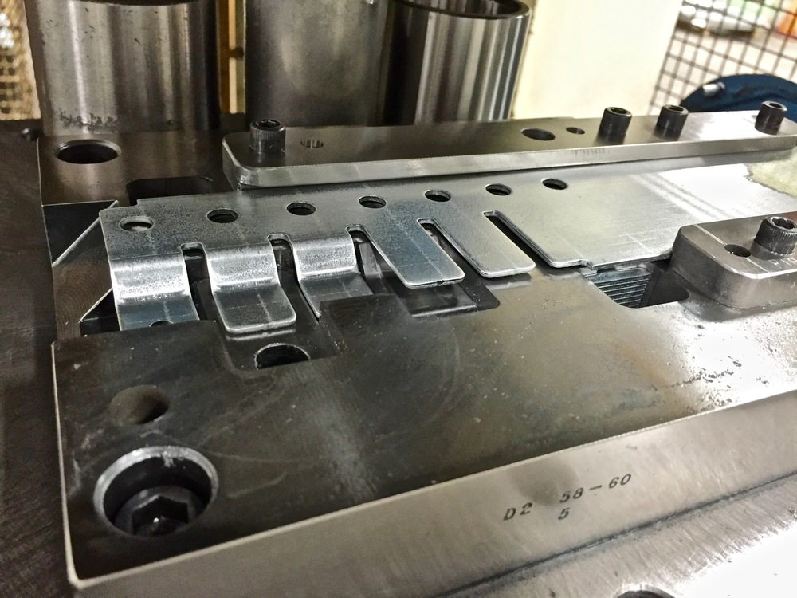
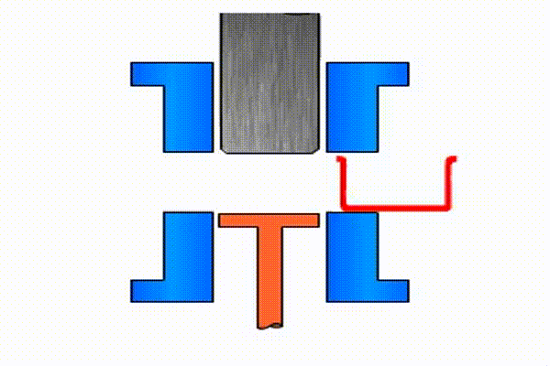
Metal Stamping Mass Fabrication
For mass production of sheet metal parts.
https://www.youtube.com/watch?v=5CuJjSk4U38

Slide 11
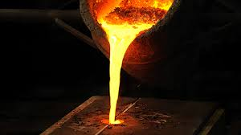
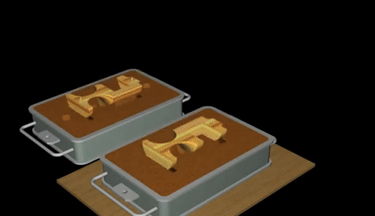
Casting
Mass Fabrication
For production of metal parts.
https://www.youtube.com/watch?v=pwaXCko_Tkw

